Slide 1
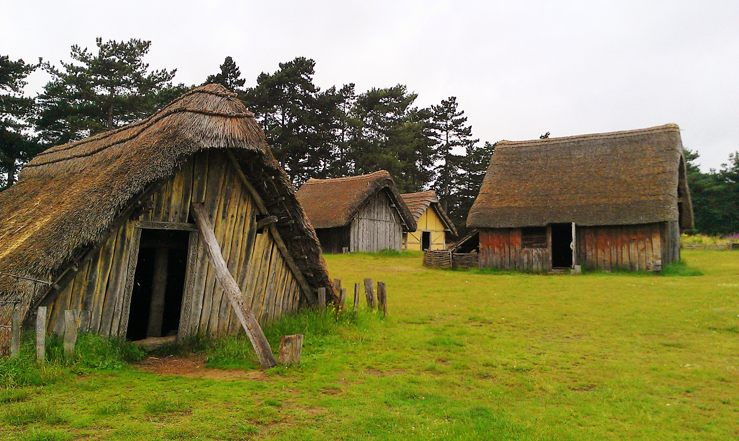
Who were the Anglo-Saxons?

Slide 2
The Roman Empire in 210 A.D.

Slide 3
Modern Northern Europe

Slide 4
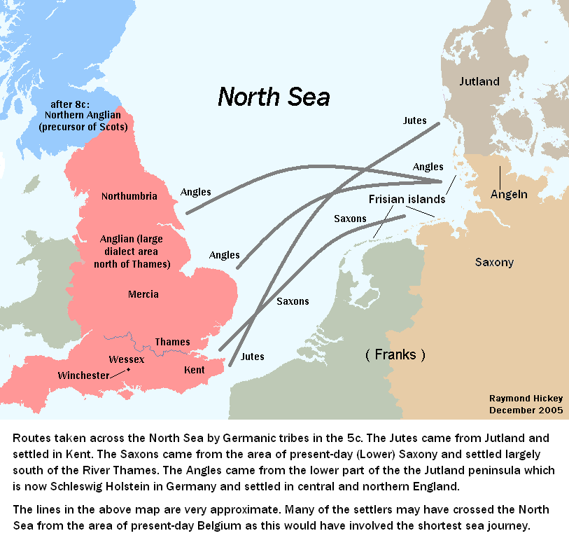
Migrations in the 5th Century

Slide 5
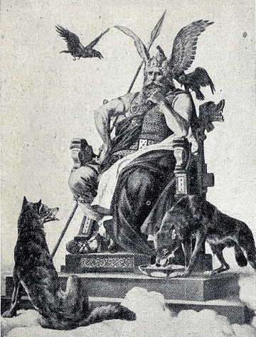
Wodin
Thor

Slide 6
Wodin
“Wodin’s Day”
Thor
“Thor’s Day”

Slide 7
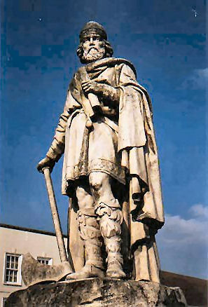
Alfred the Great (849-899 AD)

Slide 8
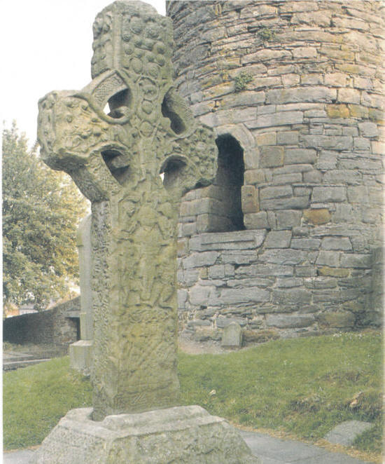

Slide 9
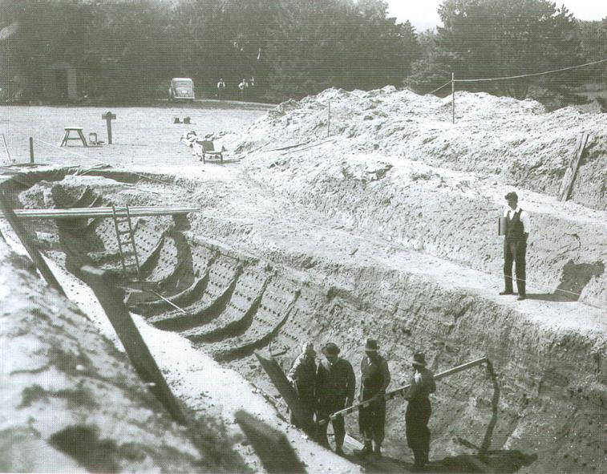
The Sutton Hoo Treasure

Slide 10
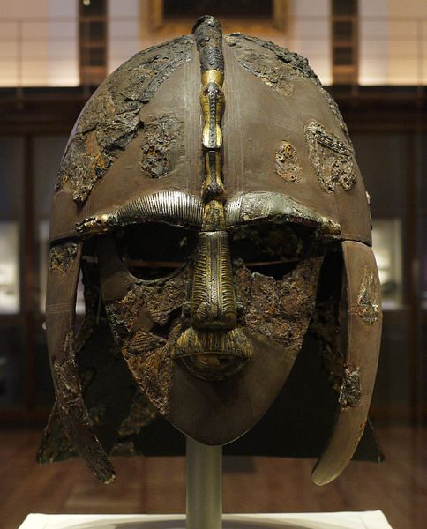
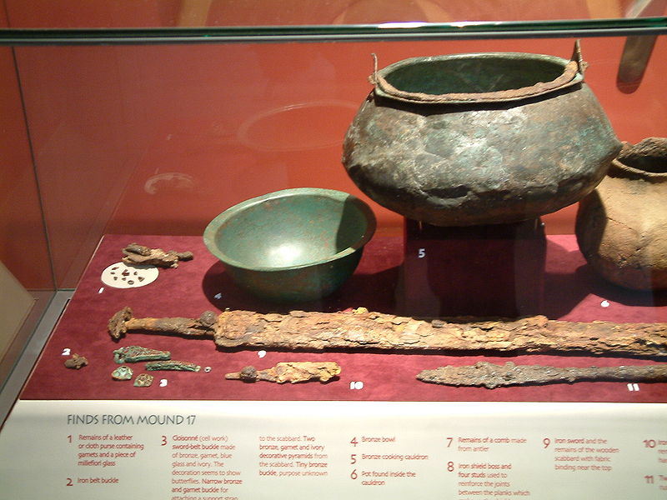
The Sutton Hoo Treasure

Slide 12
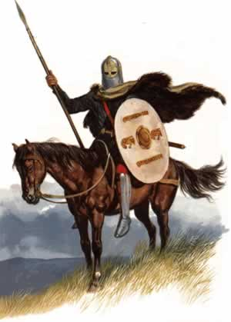
Anglo-Saxon values
Bravery
Loyalty
Generosity
Friendship

Slide 13
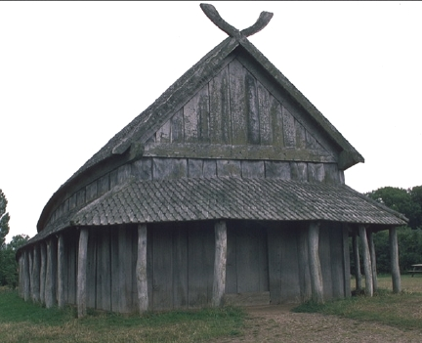
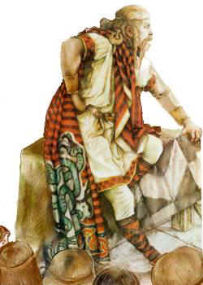
Anglo-Saxon culture
“bards”
scops

Slide 14
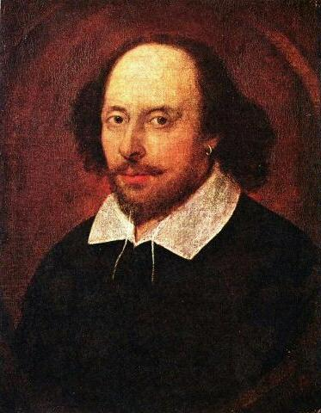
“The Bard”
?

Slide 15
“The Bard”

Slide 16
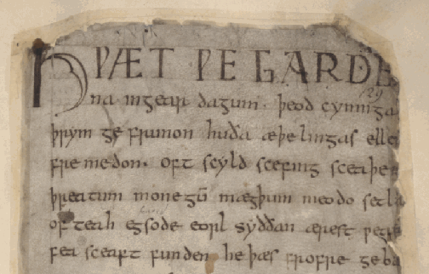
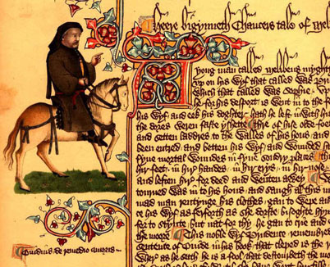
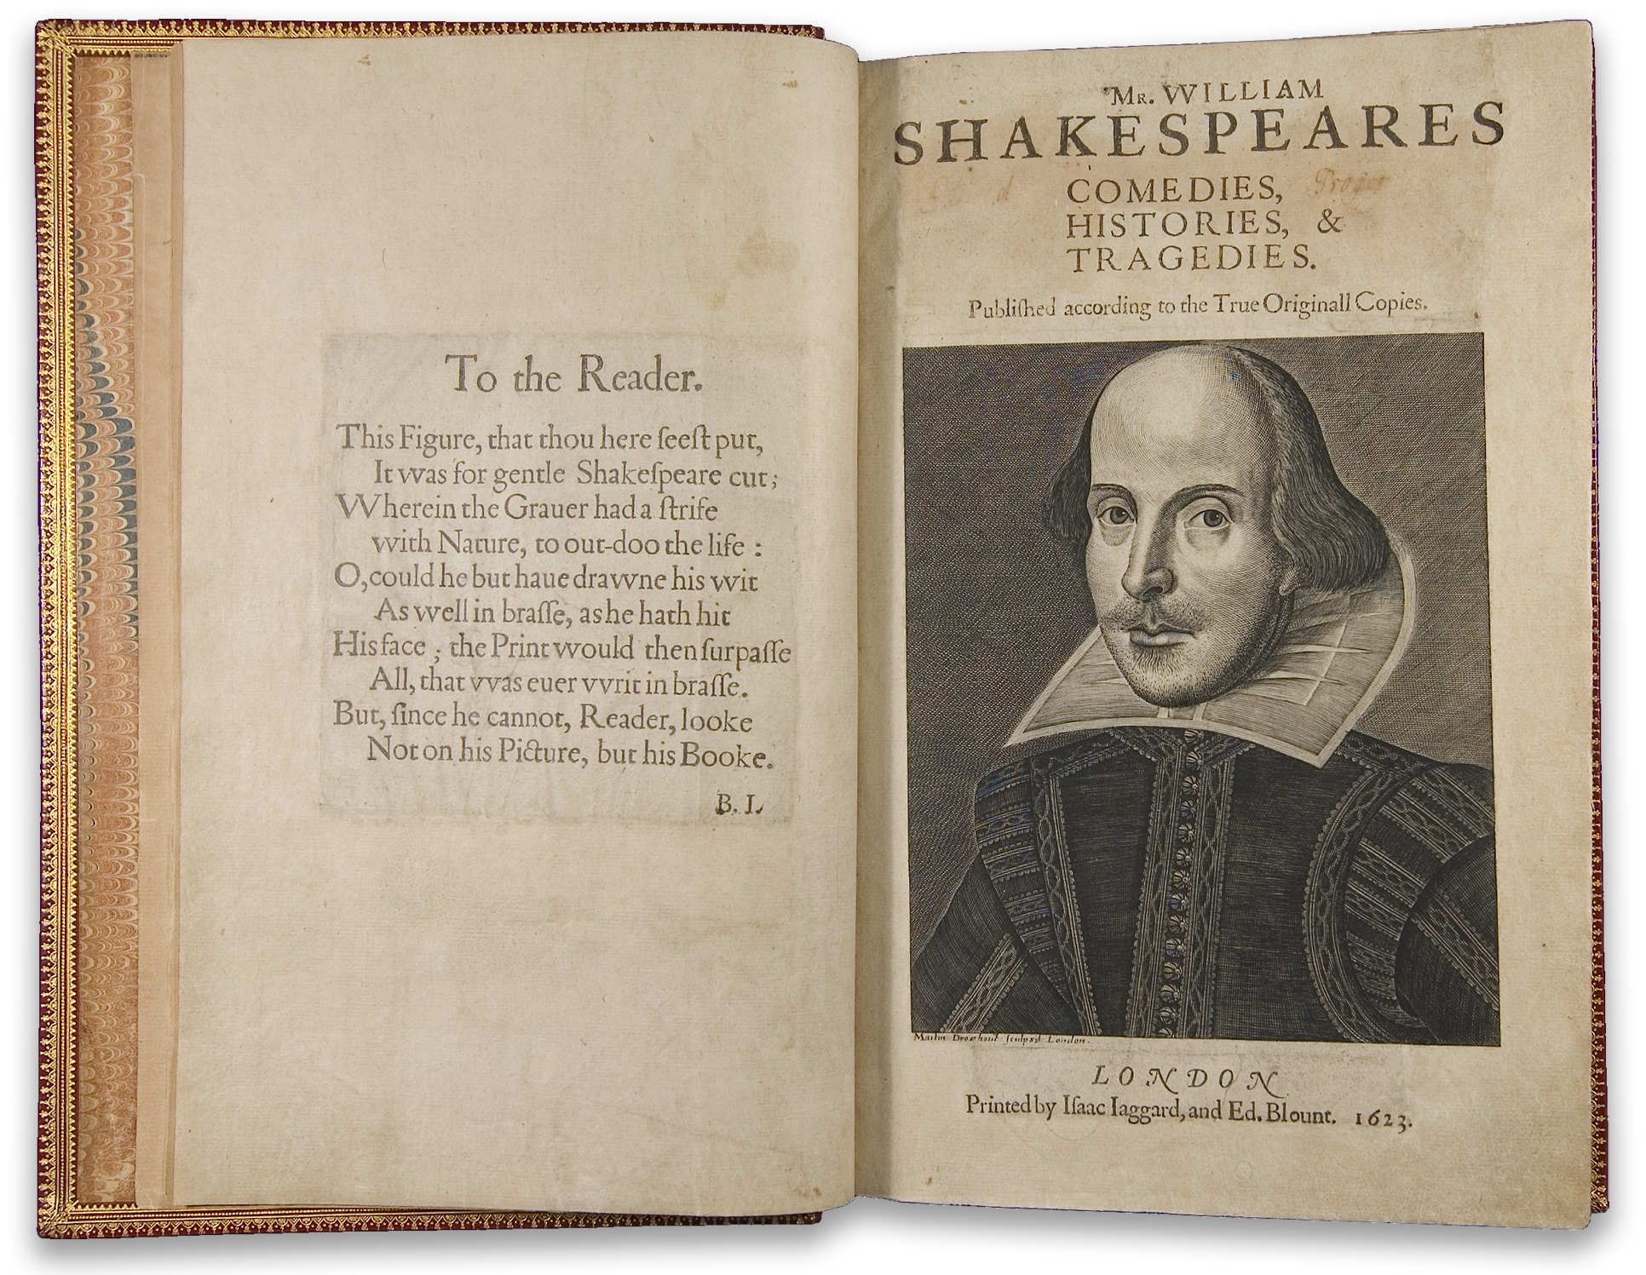
The English Language
Old English (449-1100 AD)
Middle English (1100-1500 AD)
Modern English (1500-the present)

Slide 17
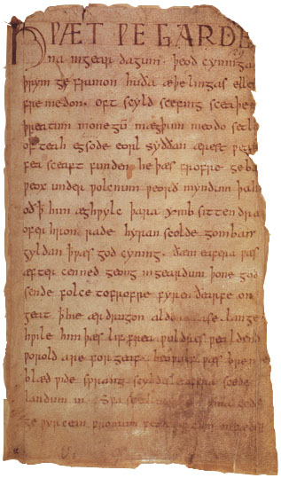

Slide 18
þæt wæs god cyning

Slide 19
þæt wæs god cyning”
“That was [a] good king”

Slide 20
Features of Anglo-Saxon poetry
Kennings
Alliteration
Cæsura
Variation

Slide 21
Kennings
From the Norse word “kenna” or “to know or recognize”
Like “miniature riddles”.
helmberend—"helmet bearer" = "warrior”
beadoleoma—"battle light" = "flashing sword”
swansrad—"swan road" = "sea"
banhus— “bone house” = human body

Slide 22
Alliteration
The repetition of consonant sounds
“She sells seashells by the seashore”
“…laying the lazy languid line along”

Slide 23
Cæsura
Latin for “a cutting”.
A pause in the middle of a line dictated by the natural rhythm of the language.
“Sing, o goddess, the rage of Achilles, the son of Peleus.”

Slide 24
Cæsura
Latin for “a cutting”.
A pause in the middle of a line dictated by the natural rhythm of the language.
“Sing, o goddess, the rage || of Achilles, the son of Peleus.”

Slide 25
Variation
Using different words for effect.
Beowulf = “Edgetho’s Son”
The nobleman’s son then passed
The steep rocky cliffs, the narrow path
The narrow single-file path, an unknown way
Precipitous headland, the homes of many water-monsters

Slide 26
Features of Anglo-Saxon poetry
Kennings – a compound word used to express meaning
Alliteration – the repetition of consonant sounds
Cæsura – a pause near the middle of a line
Variation – repeating something using different wording

Slide 27
Hero Archetypes
An archetype is a pattern that appears again and again in works of literature or media. Archetypes can be plots, characters or images.
What are some characteristics of the archetypal hero?
An epic is a quest story on a grand scale.
An epic hero is the central figure in a long narrative that reflects the values and heroic ideals of a particular society.

Slide 28
Hero Archetypes
An archetype is a pattern that appears again and again in works of literature or media. Archetypes can be plots, characters or images.
What are some characteristics of the archetypal hero?
An epic is a quest story on a grand scale.
An epic hero is the central figure in a long narrative that reflects the values and heroic ideals of a particular society.

Slide 29
Hero Archetypes
An archetype is a pattern that appears again and again in works of literature or media. Archetypes can be plots, characters or images.
What are some characteristics of the archetypal hero?
An epic is a quest story on a grand scale.
An epic hero is the central figure in a long narrative that reflects the values and heroic ideals of a particular society.

Slide 30
Hero Archetypes
An archetype is a pattern that appears again and again in works of literature or media. Archetypes can be plots, characters or images.
What are some characteristics of the archetypal hero?
An epic is a quest story on a grand scale.
An epic hero is the central figure in a long narrative that reflects the values and heroic ideals of a particular society.

